Slide 1
Contradictory, My Dear Watson
Detecting contradiction and entailment in multilingual text using TPUs

Slide 2
NLI
Natural Language Inferencing (NLI) is a common NLP task that entails finding the relationship between two sentences (a premise and a hypothesis).
Example from the dataset:
Premise:
Eg: These are issues that we wrestle with in practice groups of law firms, she said.
Hypothesis:
Eg: Practice groups are not permitted to work on these issues.

Slide 3
Problem Statement
If you have two sentences, there are three ways they could be related:
1. Entailment
2. Contradiction
3. Unrelated
Expectations
Our job is to build an NLI model that allocates labels of 0, 1, or 2 which represents entailment, neutrality and contradiction respectively to the pairs of premises and hypothesis.

Slide 4
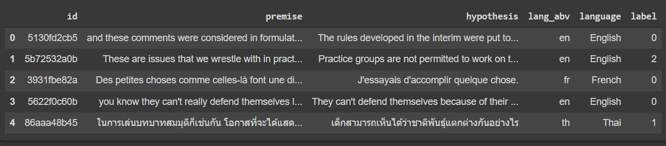
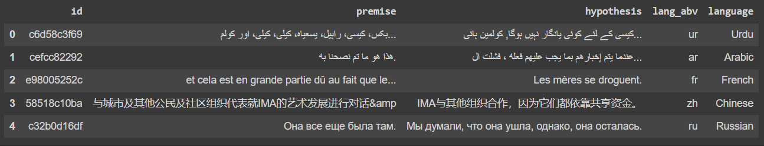
Datasets
Training dataset
Testing dataset
The shape of training dataset is (12120, 6)
The dataset contains samples of 15 different languages
Has the label column
Majority of the records belong to English language(6870)
The shape of testing dataset is (5195, 5)
Test data also contains samples of 15 different languages
Has no label column
Majority of the records belong to English language(2954)

Slide 5
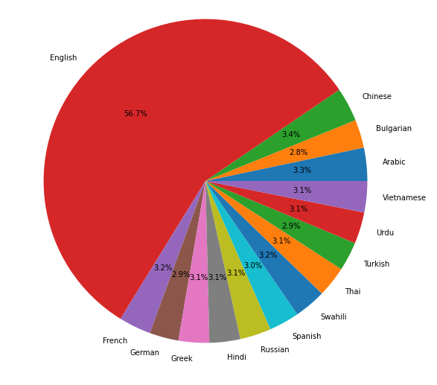
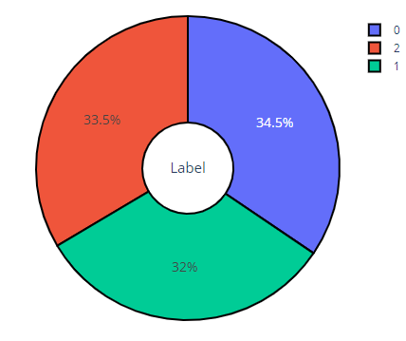
EDA
Language distribution
Label distribution

Slide 6
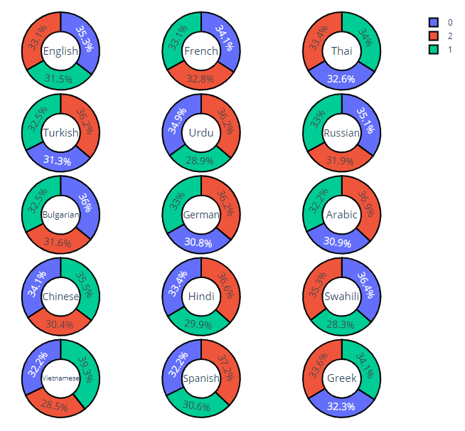
EDA
Language specific label distribution

Slide 7
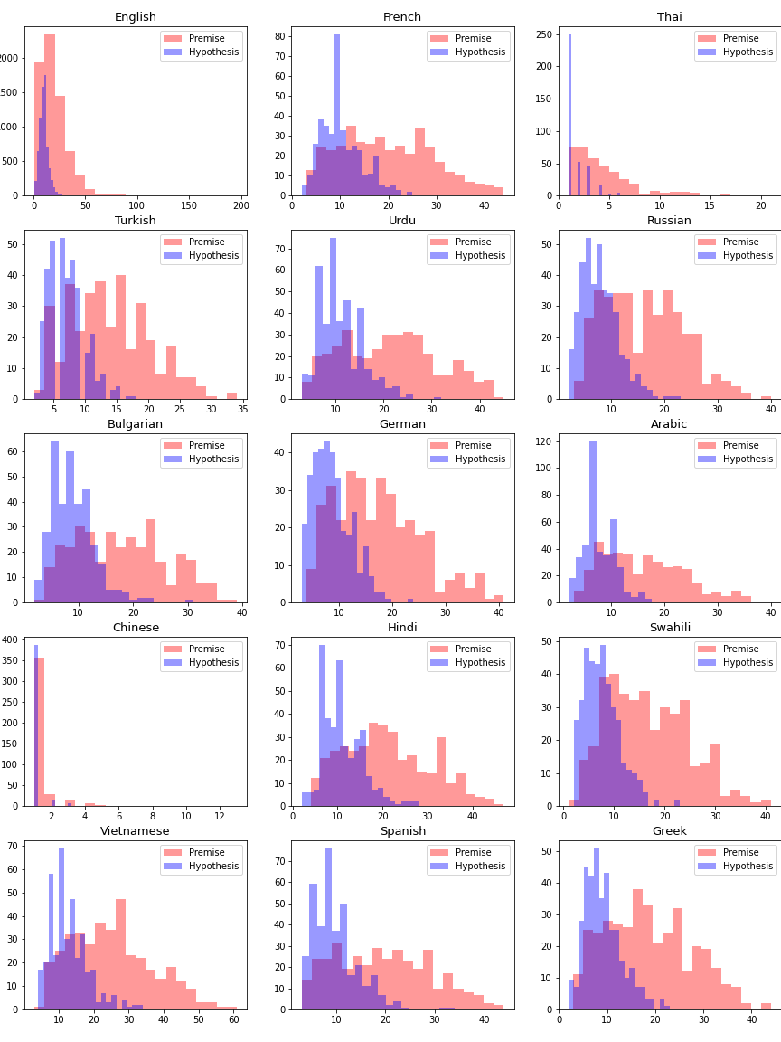
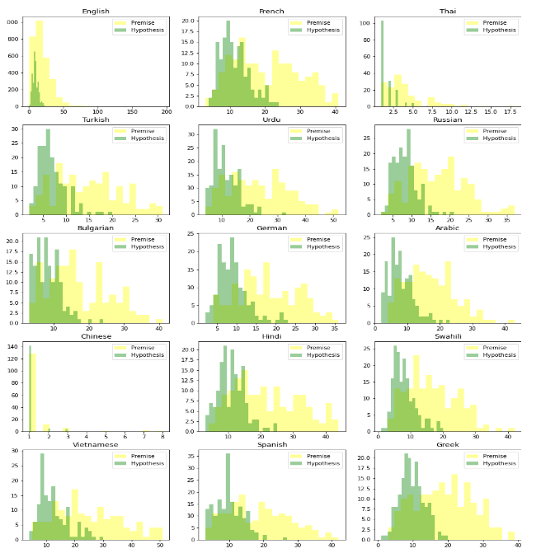
EDA
Training
Testing

Slide 8
Traditional methods
Models Used | Algorithm
1. CountVectorizer | Gradient Boosting
2. TF-IDF Vectorizer | Gradient Boosting
3. Word2Vec | LSTM

Slide 9
Disadvantages of LSTMs
Difficult to train
Very long gradient paths
Transfer learning never really worked
Specific labelled dataset for each new task

Slide 10
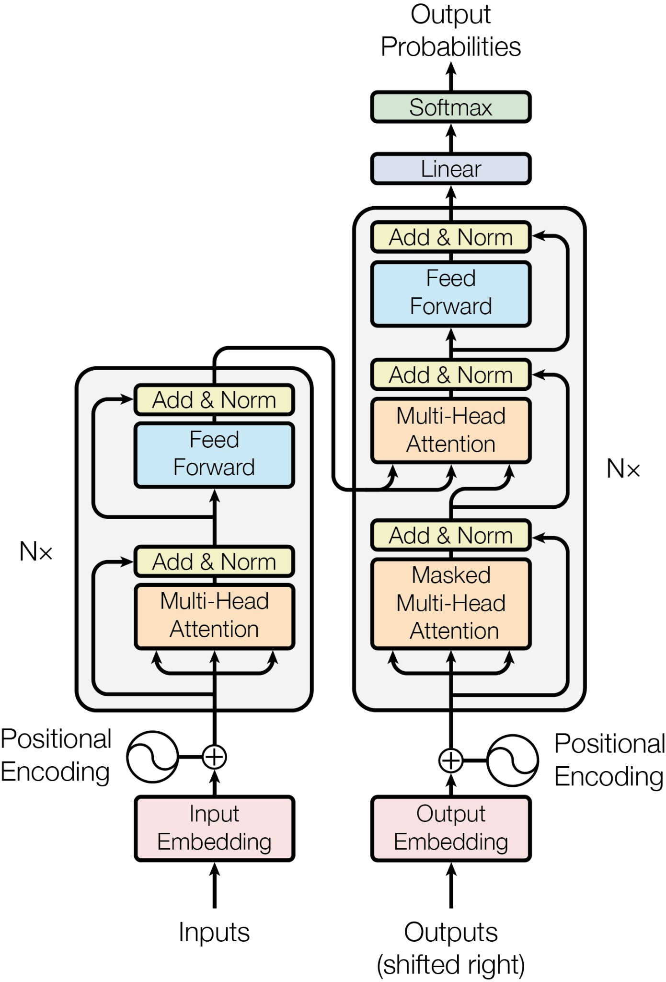
Transformers

Slide 11
Encoder

Slide 12
BERT
Bidirectional Encoder Representation from Transformers (BERT)
Can be used on a wide variety of language tasks:
Sentiment Analysis
Question answering
Text prediction
Text generation
Summarization
Polysemy resolution

Slide 13
BERT Pretraining
Large amount of data:
3.3 Billion Words (Wikipedia + BookCorpus)
64 TPUs for 4 days
Masked Language Modelling
Next Sentence Prediction

Slide 14
MLM and NSP
Masked Language Modelling:
In Autumn the ______ fall from the trees
Next Sentence Prediction:
Paul went shopping. He bought a new shirt.
Ramona made coffee. Vanilla ice cream cones for sale.

Slide 15
Proposed model
Transformers
Model Used
1.BERT
2. DistilBERT
3. AlBERT
4. RoBERTa

Slide 16
Bert Variants - RoBERTa
Enhanced version of Bert
Has more Training Parameters
Doesn’t have Next Sentence Predictor
Trained on Large Mini Batches
Trained on Multilingual Dataset
Has a base and large model for the multilingual model

Slide 17
Bert Variants - AlBERT
Lite version of Bert
Has least Training Parameters
Has Sentence ordering Prediction (SOP)
Not Trained on Multilingual Dataset

Slide 18
Bert Variants - DistilBERT
Distilled version of Bert - faster, cheaper and lighter
Has 66 Million Training Parameters
Using Teacher - Student Framework
Trained on Multilingual Dataset
Doesn’t have a large model only has a base model

Slide 19


Model | Multilingual | More Encoders
Bert
Roberta
Albert
DistilBert

Slide 20
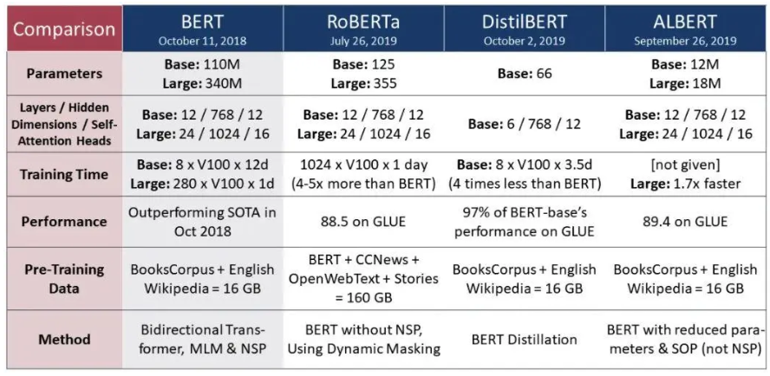
Transformer Models Comparison

Slide 21
External Datasets
MNLI | XNLI | SNLI
433k sentence pairs | 400k sentence pairs | 570k sentence pairs
Data Split: Train+Validation-matched+validation-mismatched | Data split: Train+Test+Validation | Data split: Train+Validation+Test
Contains only English language sentences | Contains 14 other languages along english | Contains only English language sentences
Hybrid - Combination of any of the above datasets

Slide 22
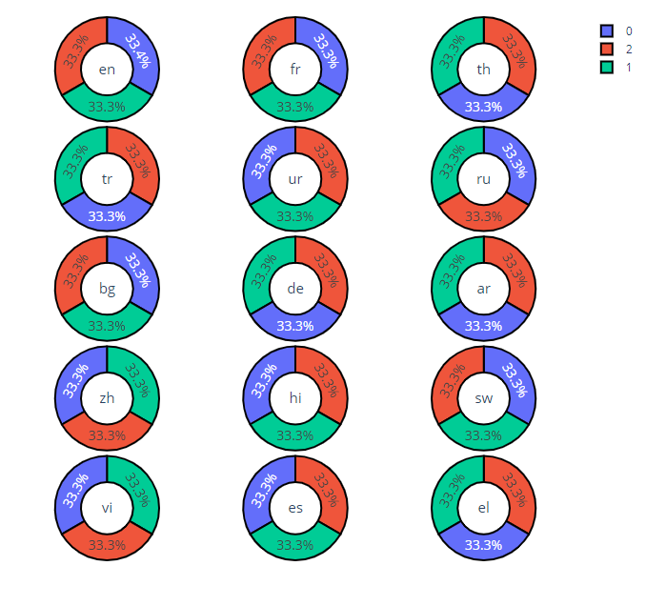
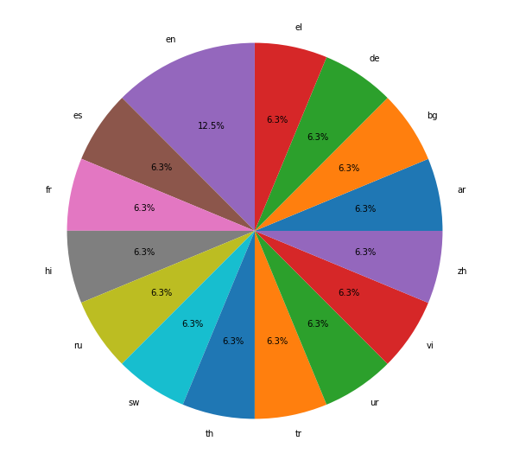
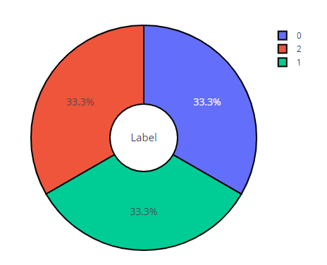
External Datasets
(2)
(3)
(1)
Data and Label distribution of Hybrid(mnli+xnli) dataset

Slide 23
Results
Model | Original Data | With MNLI | With XNLI | With SNLI | Hybrid (MNLI + XNLI)
1. Count Vectorizer | 0.34706 | 0.34801 | 0.34879 | 0.33165 | -
2. TF-IDF Vectorizer | 0.35192 | 034915 | 0.34978 | 0.34663 | -
3. Word2Vec | 0.38787 | 0.4015 | 0.3861 | 0.31583 | -
4. BERT | 0.65081 | 0.67372 | 0.6985 | 0.34015 | 0.69682
5. ALBERT | 0.71106 | 0.7104 | 0.70992 | 0.66924 | 0.72106
6. DistilBERT | 0.56823 | 0.65601 | 0.61174 | 0.33970 | 0.66562
7. RoBERTa | 0.79826 | 0.89008 | 0.87834 | 0.34706 | 0.95707

Slide 24
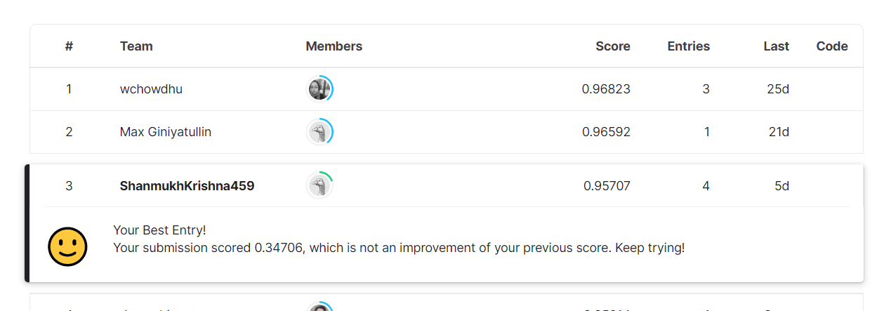
Kaggle standings
The above result is for the model which is done with hybrid dataset(mnli+xnli) using RoBERTa.

Slide 25
References
Ashish Vaswani, Noam Shazeer, Niki Parmar, Jakob Uszkoreit, Llion Jones, Aidan N. Gomez, Lukasz Kaiser, & Illia Polosukhin. (2017). Attention Is All You Need.
Thomas Wolf, Lysandre Debut, Victor Sanh, Julien Chaumond, Clement Delangue, Anthony Moi, Pierric Cistac, Tim Rault, Rémi Louf, Morgan Funtowicz, Joe Davison, Sam Shleifer, Patrick von Platen, Clara Ma, Yacine Jernite, Julien Plu, Canwen Xu, Teven Le Scao, Sylvain Gugger, Mariama Drame, Quentin Lhoest, & Alexander M. Rush (2020). Transformers: State-of-the-Art Natural Language Processing. In Proceedings of the 2020 Conference on Empirical Methods in Natural Language Processing: System Demonstrations (pp. 38–45). Association for Computational Linguistics.
Contradictory, my dear Watson. Kaggle. (n.d.). Retrieved May 12, 2022, from https://www.kaggle.com/competitions/contradictory-my-dear-watson/overview
Samuel R. Bowman, Gabor Angeli, Christopher Potts, and Christopher D. Manning. 2015. A large annotated corpus for learning natural language inference. In Proceedings of the 2015 Conference on Empirical Methods in Natural Language Processing (EMNLP).
Conneau, A., Rinott, R., Lample, G., Williams, A., Bowman, S., Schwenk, H., & Stoyanov, V. (2018). XNLI: Evaluating Cross-lingual Sentence Representations. In Proceedings of the 2018 Conference on Empirical Methods in Natural Language Processing. Association for Computational Linguistics.
Williams, A., Nangia, N., & Bowman, S. (2018). A Broad-Coverage Challenge Corpus for Sentence Understanding through Inference. In Proceedings of the 2018 Conference of the North American Chapter of the Association for Computational Linguistics: Human Language Technologies, Volume 1 (Long Papers) (pp. 1112–1122). Association for Computational Linguistics.

Slide 26
Thank You!
By:
B.Shanmukh Krishna
CH. Roopa Sree
Kartikeya Jain
D. Ravi Kiran

